Slide 1
The Network Layer
Chapter 5

Slide 2
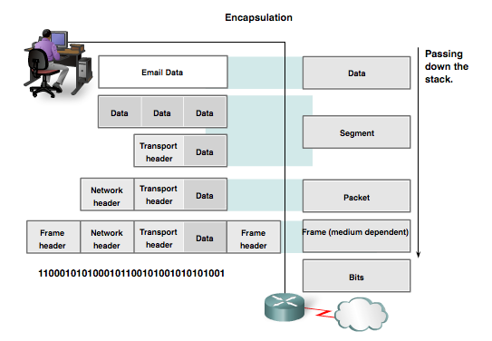
Protocol Data Units (PDUs)
Data
Segment
Packet
Frame
Bits
Notes:
3.3.1.2 Protocol Data Units (PDUs)

Slide 3

Store-and-Forward Packet Switching
fig 5-1
The environment of the network layer protocols.

Slide 4
Circuit Switching
Dedicated communication path between two stations
Three phases
  Establish
  Transfer
  Disconnect
Must have switching capacity and channel capacity to establish connection
Must have intelligence to work out routing

Slide 5
Circuit Switching - Applications
Inefficient
  Channel capacity dedicated for duration of connection
  If no data, capacity wasted
Set up (connection) takes time
Once connected, transfer is transparent
Developed for voice traffic (phone)

Slide 6
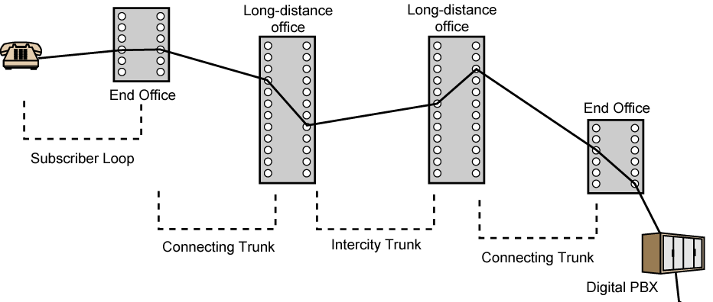
Public Circuit Switched Network

Slide 7
Telecomms Components
Subscriber
  Devices attached to network
Subscriber line
  Local Loop
  Subscriber loop
  Connection to network
  Few km up to few tens of km
Exchange
  Switching centers
  End office - supports subscribers
Trunks
  Branches between exchanges
  Multiplexed

Slide 8
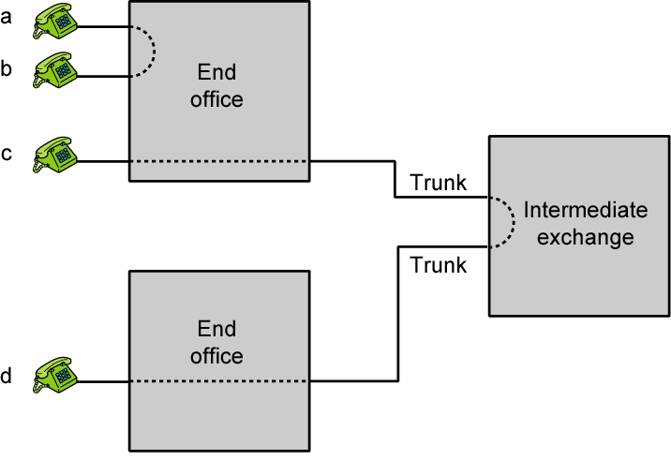
Circuit Establishment

Slide 9
Packet Switching: Basic Operation
Data transmitted in small packets
  Typically 1000 octets
  Longer messages split into series of packets
  Each packet contains a portion of user data plus some control info
Control info
  Routing (addressing) info
Packets are received, stored briefly (buffered) and past on to the next node
  Store and forward

Slide 10
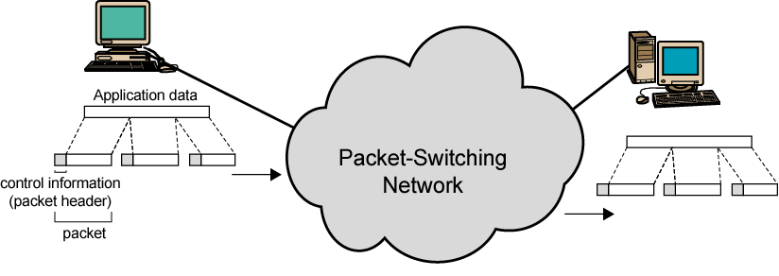
Use of Packets

Slide 11
Advantages
Line efficiency
  Single node to node link can be shared by many packets over time
  Packets queued and transmitted as fast as possible
Data rate conversion
  Each station connects to the local node at its own speed
  Nodes buffer data if required to equalize rates
Packets are accepted even when network is busy
  Delivery may slow down
Priorities can be used

Slide 12
Switching Technique
Station breaks long message into packets
Packets sent one at a time to the network
Packets handled in two ways
  Datagram
  Virtual circuit

Slide 13
Datagram
Each packet treated independently
Packets can take any practical route
Packets may arrive out of order
Packets may go missing
Up to receiver to re-order packets and recover from missing packets

Slide 14
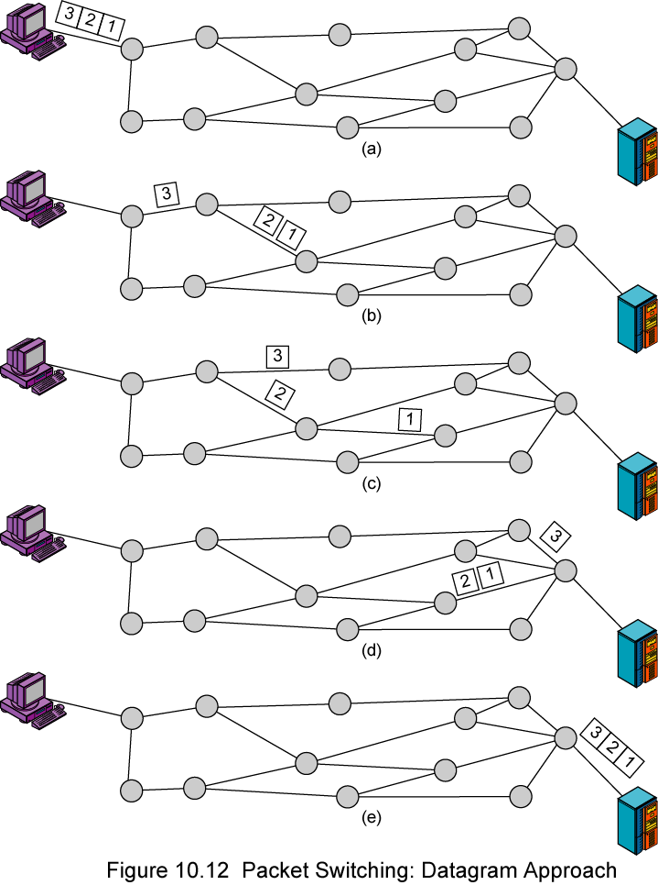
Datagram Example

Slide 15
Virtual Circuit
Preplanned route established before any packets sent
Call request and call accept packets establish connection (handshake)
Each packet contains a virtual circuit identifier instead of destination address
No routing decisions required for each packet
Clear request to drop circuit
Not a dedicated path: sharing possible

Slide 16
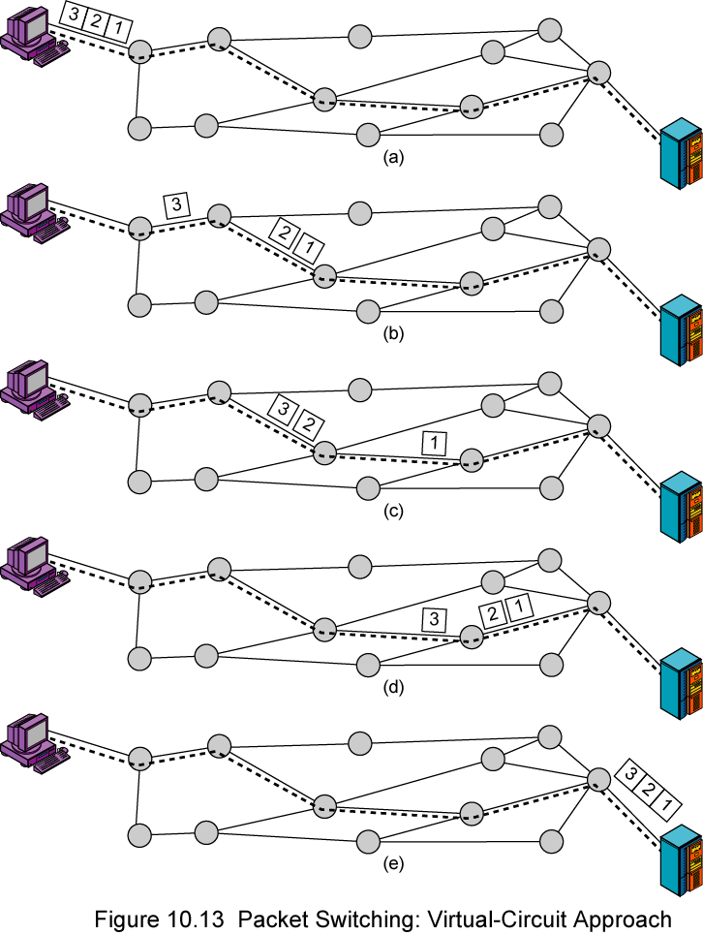
Virtual Circuit

Slide 17
Virtual Circuits vs. Datagram
Virtual circuits
  Network can provide sequencing and error control
  Packets are forwarded more quickly
    No routing decisions to make
  Less reliable
    Loss of a node looses all circuits through that node
Datagram
  No call setup phase
    Better if few packets
  More flexible
    Routing can be used to avoid congested parts of the network

Slide 18

Routing in Datagram Subnet

Slide 19

Routing in Virtual Circuit

Slide 20

Comparison of Virtual-Circuit and Datagram Subnets
5-4

Slide 21
Main Tasks of Network Layer
The network layer, or OSI Layer 3, provides services to allow end devices to exchange data across the network. To accomplish this end-to-end transport, the network layer uses four basic processes:
Addressing end devices --- Already covered
Encapsulation
Routing => Will be covered next
De-encapsulating
Notes:
6.1.1.1 The Network Layer

Slide 22
Routing Algorithms
The Optimality Principle
Shortest Path Routing
Flooding
Distance Vector Routing
Link State Routing
Hierarchical Routing
Broadcast Routing
Multicast Routing
Routing for Mobile Hosts
Routing in Ad Hoc Networks

